Slide 1
Talk title
SPEAKER NAME
Venue, city
Date

Slide 2
How do rocky worlds form and evolve?

Slide 3
Lava worlds open a window into the interior
PART 2

Slide 4
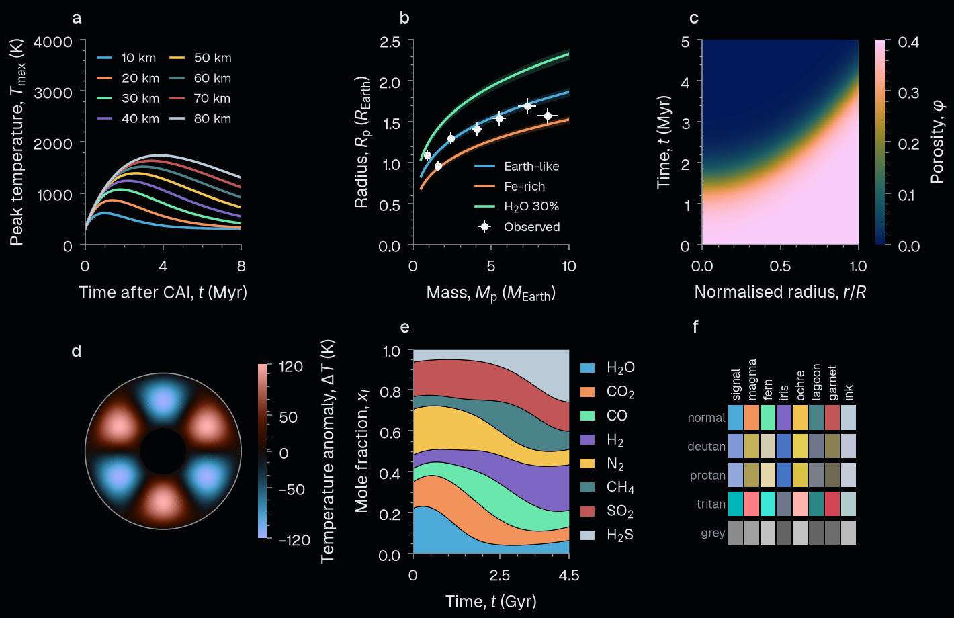
Lava world atmospheres are fed from the interior
Outgassing follows the redox state of the magma
Nicholls+ 25 MNRAS

Slide 5
Residual atmospheres are mass-sorted
Lichtenberg+ 25 Science

Slide 6
Sulfur species trace the interior phase state
Teske+ 25 ApJL
Lichtenberg & Miguel 25 Treatise on Geochemistry

Slide 7
1. First take-home point
Author+ 25
Author & Author 26
2. Second take-home point
Author+ 24
3. Third take-home point
Author+ 26a,b

Slide 8
A common assumption, stated plainly.

Slide 9
Forming Worlds Lab

Slide 10
How do rocky worlds form and evolve?
Open positions: formingworlds.space

